Slide 1
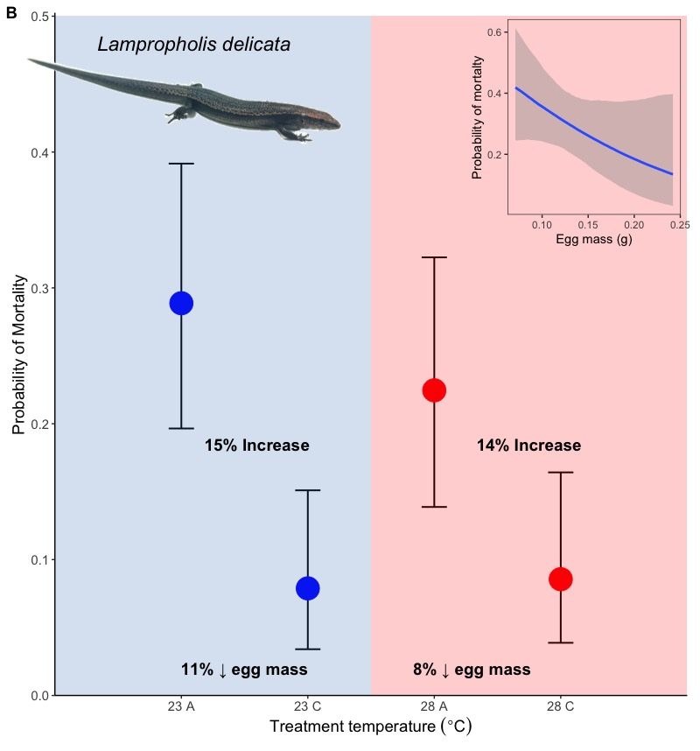
A = Ablation
C = Control
p(mortality) ~ egg mass + incubation temp + egg mass: incubation temp + (1|clutch)

Slide 2



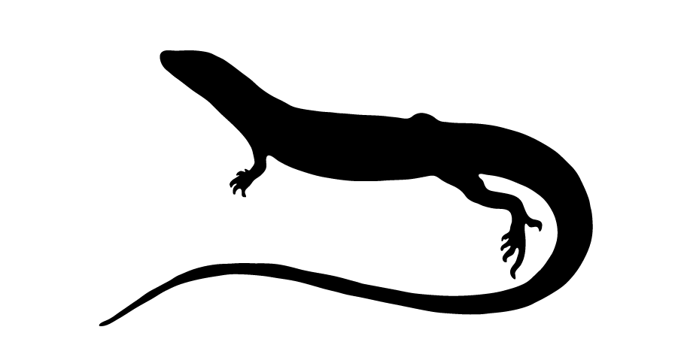
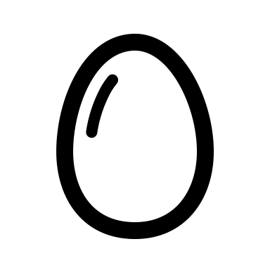
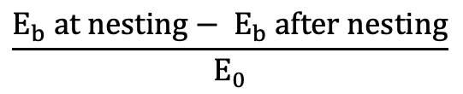
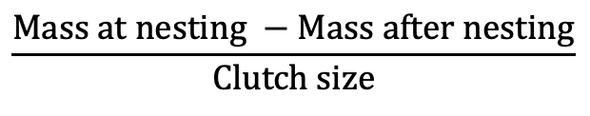
Locations
Mom model
Egg model
Nesting dates
Reproductive events
$$\frac{E_{b} at nesting− E_{b} after nesting}{E_{0}}$$
Mean incubation temp 35 d after nesting event @10cm
= Clutch size
$$\frac{Mass at nesting −Mass after nesting}{Clutch size}$$
= Egg mass
p(mortality) ~ egg mass + incubation temp + egg mass: incubation temp + (1|clutch)

Slide 3
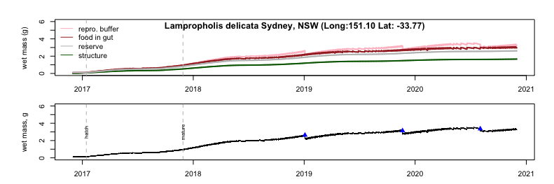
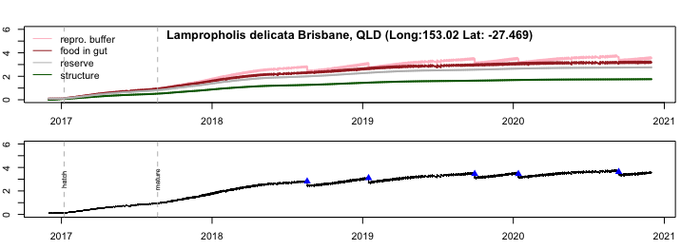
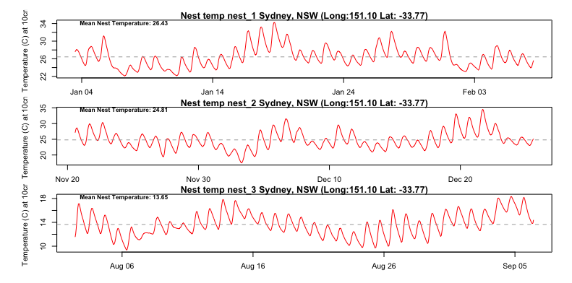
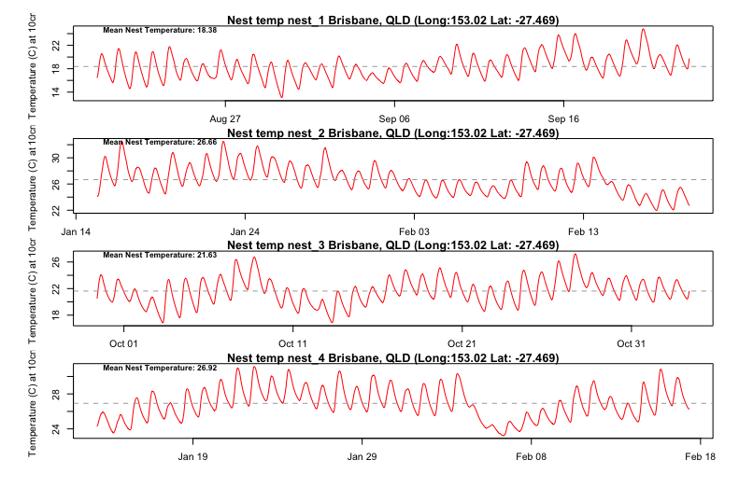
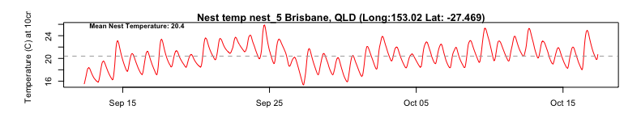

Slide 4
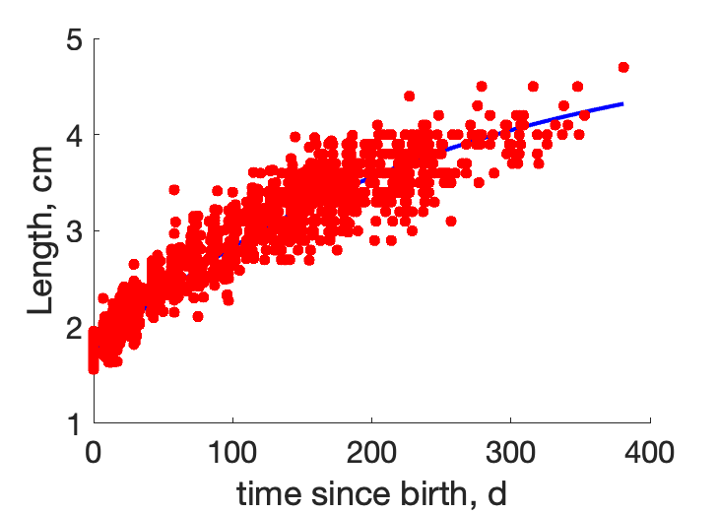
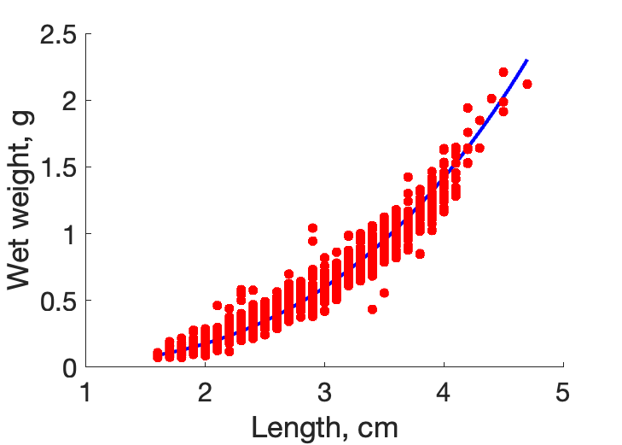
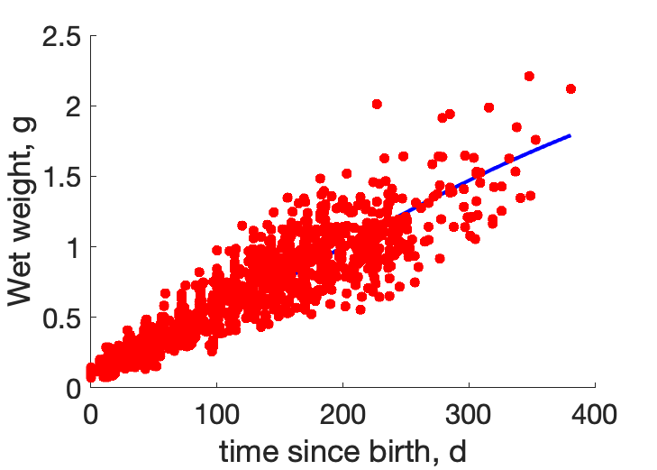
MatLab output

